Slide 1
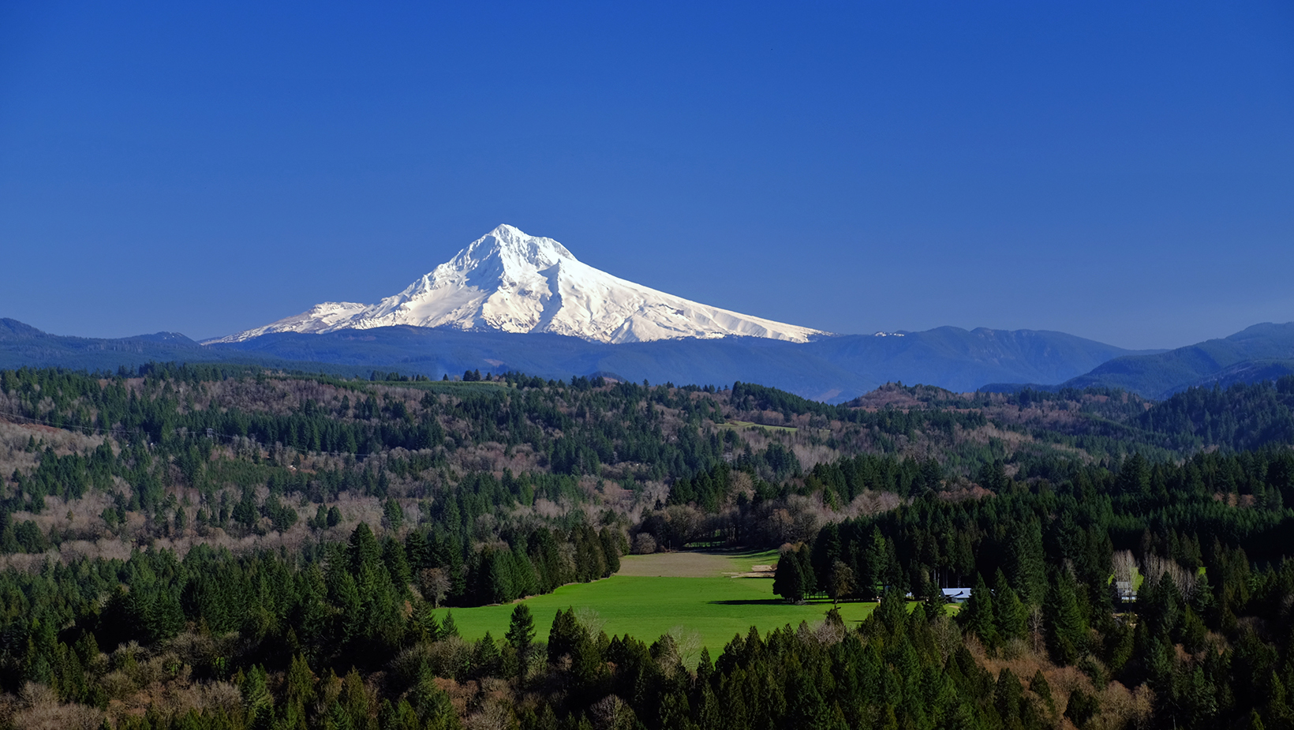
ANNUAL HOA MEETING

Slide 2
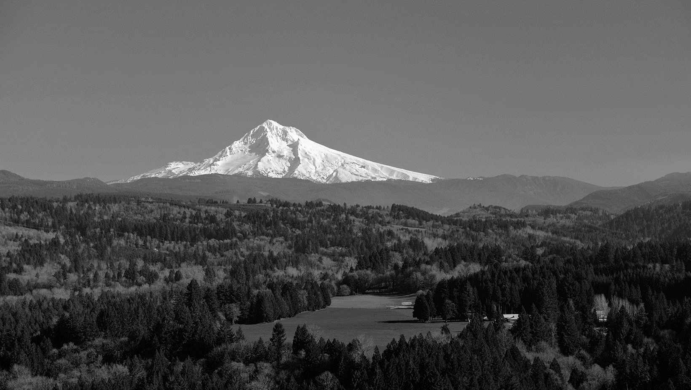
ANNUAL HOA MEETING
Roll Call
Reading of Minutes of Preceding Meeting
2020 Year in Review – (No cursing, please. Kids present…)
Elections
Unfinished Business
New Business
Adjournment

Slide 3
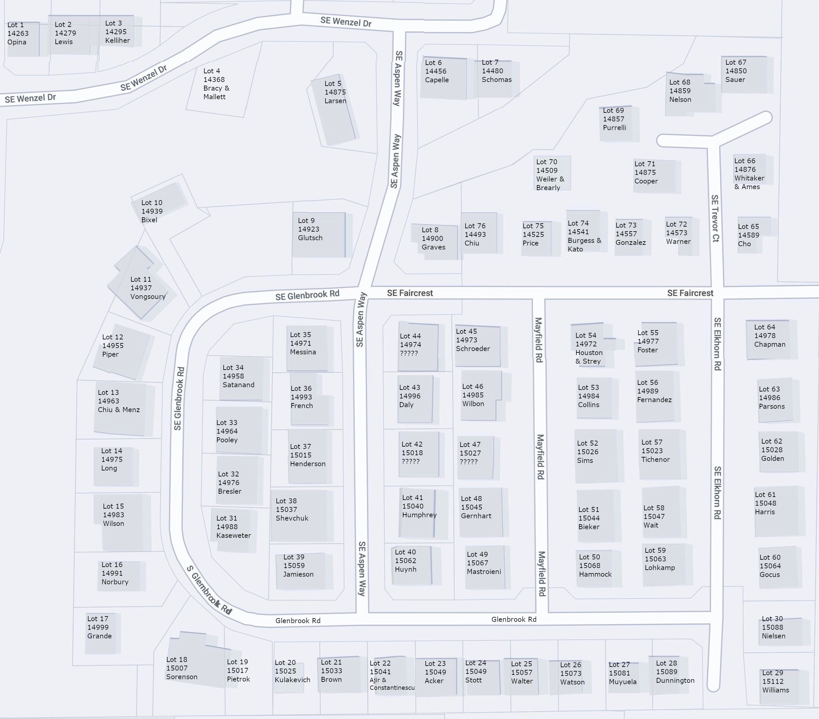
Roll Call!
Roll Call of HomeOwners
HOA Board Intros
Michael Walter – President
Jim Harris - Treasurer
Rob Grande – Secretary
Committees
ACC
Christman
Ramirez
Schoenheit
Epperson
Manuel
Nguyen
Brehm
Epperson

Slide 4
2020 Meeting Minutes
Committee Report
Safety
Be aware of car speeds
Be aware of children
Be aware street prowling
Architectural
If making changes to structures or house colors, notify the ACC
Social
Annual BBQ postponed to 2021 due to Covid
Wine Wednesdays are tentative
National Night Out is tentative
Bunco is tentative
Thank you to Jean and Lydia for organizing these
Nominations for President, Treasurer, and Secretary
Unanimous vote:
President: Michael Walter
Treasurer: Terry Humphrey
Secretary: Robert Grande
Other Business
Street tree maintenance
We got a good bid, but we have more to get done
Landscape Maintenance Contract
Proscape to be fired
Michael Walter to get bids for new landscape company
CC&R Fine Addendums
These are in the works for the 2020-2021 year
Open Items
Street Parking - Issues with street parking on Glenbrook

Slide 5
Annual Reports
President
New Contracts
Community Business
Treasurer
Financials
Committees

Slide 6
Elections
President – NOMINATIONS
Michael Walter – Term end June 21. Thanks for your service, Michael!
Treasurer
Jim Harris – Took over for Terry Humphrey in March ’21 for 2 year term
Secretary – Rob Grande – Term end June ‘22?

Slide 7
2020 In Memorium
Plague/Pestilence, Ice Storms, Fire Dangers, Security
Did we do ok as a community? Lessons Learned?

Slide 8
2021 New Business
Neighborhood Watch
Tree and Hedge Trimming responsibilities
Report Dead Trees
Dues in August
Fire Safety

Slide 9
2020 Fire Safety – Lessons Learned
Keep the five feet closest to homes clear of combustibles potentially using noncombustible rock or gravel as mulch.
Trim back vegetation and overhanging branches to a distance of 10 feet away from homes or decks.
Remove ladder fuels to create a separation between low-level vegetation and tree branches to keep fire from climbing up trees. Limb up the bottom branches of trees to 6-10 feet.
Remove leaf and needle debris from yards, roofs, and gutters.
Keep grass and groundcover under 4” in height.
Maintain spacing between trees and shrubs. Ideally 10 feet between trees.
Remove dead trees and debris from yards and green spaces.

Slide 10
2020 Fire Safety – Lessons Learned

Slide 11
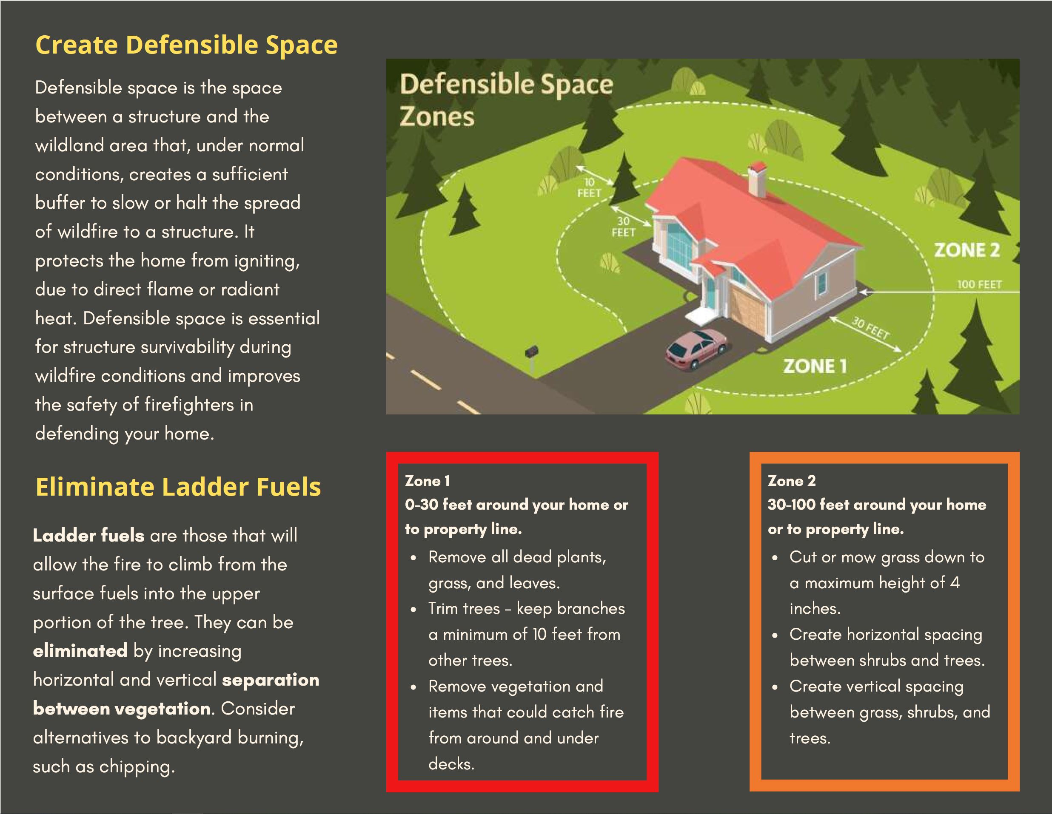
2020 Fire Safety – Lessons Learned

Slide 12
2021 Ahead
Re-emergence
Wine Weds
Book Clubs
Team Wenzel Block Party 2021 – 25 June
Road Work 142nd from 212-Wenzel – Summer ‘21
Neighbor responsibilities
Green Spaces, Tree/Shrub pruning, Yard Debris, etc.

Slide 13
Questions?

